Slide 1
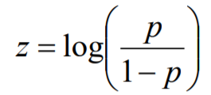

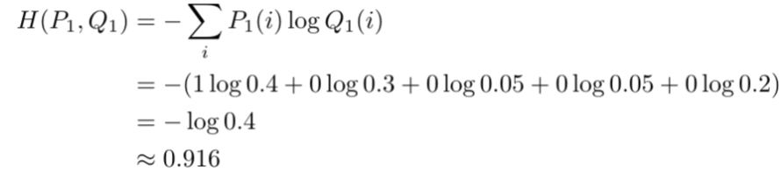


Input Layer
Weighted Connection
Hidden Layer
i1
w1
Logits
(-inf, inf)
h1
w’1
w2
Weighted Connection
Mapping probability
i1
w7
Odds
(0, inf)
Pi/(1-Pi)
w3
w8
w9
w’2
h2
w’’1
i1
h1
w'1
mapping
softmax
w4
w10
Activation
function
out
Probabilities
(0,1)
w13
w'2
Pi
w11
w14
w’’2
i1
w15
w’3
w'3
h2
w5
w12
h1
tf.nn.softmax_cross_entropy_with_logits_v2()
w16
w'4
mapping
i1
w17
w’4
w6
w18
b3
h1
Cross Entropy
(0,1)
i1
b2
b2
b1
b1
Calculate
Error
Loss function
b
b
Back Propagation
on errors
Mean Square Error

